Slide 1
virtualization security - OVERVIEW

Slide 2
MODERN BUSINESS IS UNDER PRESSURE TO DO MORE, AND SPEND LESS
Business optimisation is key to driving productivity with
Notes:
In today’s competitive environment – with businesses trying to boost efficiency and cut costs – virtualization is no longer the preserve of multinational enterprises and large-scale data centres. By promising opportunities to:
Run more applications and services – on fewer servers
Cut hardware acquisition costs
Reduce operational costs related to maintenance, space and energy

Slide 3
BUT DEPLOYING NEW TECHNOLOGIES TO DRIVE EFFICIENCY CAN BE RISKY
New technologies bring new security threats with the constant evolution of ever more sophisticated malware:
Disrupting your business processes – and increasing your operational costs
Stealing and exposing your confidential business information
Compromising the security of your suppliers’ and customers’ data
Destroying the competitive advantage that your business gains from its intellectual property
Notes:
In today’s competitive environment – with businesses trying to boost efficiency and cut costs – virtualization is no longer the preserve of multinational enterprises and large-scale data centres. By promising opportunities to:
Run more applications and services – on fewer servers
Cut hardware acquisition costs
Reduce operational costs related to maintenance, space and energy

Slide 4
ANTI MALWARE ATTACKS ARE INCREASING IN NUMBER AND SOPHISTICATION ALL AROUND THE WORLD
Malware attacks are accelerating as technology develops
The type and sophistication level of threats are constantly evolving
Opportunities for threats to find security gaps have never been greater
Myths and misinformation remain on how best to protect virtual machines
Virtual environments are often the least protected areas of IT infrastructure

Slide 5
VIRTUALIZED ENVIRONMENTS ARE INCREASINGLY ATTRACTIVE TO BUSINESS OF ALL SIZES BUT ARE NO MORE SECURE THAN ‘REAL’ ONES
More efficiency – run more on fewer servers
More applications and services
More cash flow – cut acquisition costs
More up time – business agility
Notes:
… virtualization is often an important element in the IT department’s efforts to meet the business’s demands to ‘do more and spend less’.
However, whether you’re running applications on physical or virtual machines, you still need to guard against the constant increase in the volume and sophistication of malware and other cyberthreats that could jeopardise your day-to-day operations by:
Disrupting your business processes – and increasing your operational costs
Stealing and exposing your confidential business information
Compromising the security of your suppliers’ and customers’ data
Destroying the competitive advantage that your business gains from its intellectual property

Slide 6
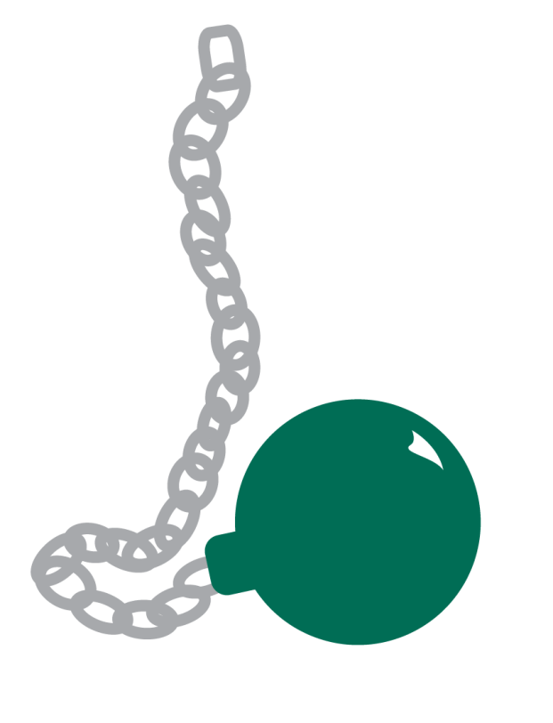
FIREWALLS ARE NO LONGER ENOUGH & AGENT BASED SECURITY SIMPLY SLOWS EVERYTHING DOWN…
Virtual servers are vulnerable to attacks from inside and outside a businesses security perimeter
Left unprotected a virtual server could be a sitting target
Cyber criminals focus on attacking your ‘weakest links’
Degrading and reducing overall network performance
Limiting virtualization ROI
Can introduce additional security gaps
Duplication of security software
Wasteful of precious data storage capacity
Notes:
Agent-based security software
This is basically the same type of package that you would install on a physical machine. In a non-virtualized environment, the full security software agent and anti-malware database are installed on the machine (server or desktop).
Generally, using these agent-based products within a virtualized environment is rarely a good idea. Each virtual machine will require the full agent and full anti-malware signature database to be installed on it. Hence, if you have 100 virtual machines running on one virtual host, you’ll have 100 instances of the security agent and 100 instances of the malware signature database on that virtual host.
Obviously, this high level of duplication of the antivirus database wastes storage capacity. In addition, with multiple instances of the security application running, performance will suffer – especially in cases where the security software is running intensive processes on multiple virtual machines on the host.
If one of the motivations behind undertaking a virtualization project is ‘doing more with less hardware’… anything that adversely affects consolidation ratios will severely handicap your virtualization project’s ability to generate a good return on investment.
In addition to wasteful duplication of the security software and databases, agent-based security can also result in phenomena that further degrade performance or lead to potential gaps in security:
‘Scanning storms’ / ‘Panic attacks’ / ‘Update storms’ / ‘Instant on gaps’

Slide 7
…CREATING WASTEFUL PROBLEMS IN YOUR VIRTUAL NETWORK THAT SERIOUSLY DEGRADE PERFORMANCE
Scanning storms when machines run scans simultaneously
Panic attacks when multiple agents working simultaneously seriously choke memory and CPU power
Update storms when multiple agents all go looking for the same info simultaneously
Instant on gaps when machines remain vulnerable after periods of inactivity
Notes:
Agent-based security software
This is basically the same type of package that you would install on a physical machine. In a non-virtualized environment, the full security software agent and anti-malware database are installed on the machine (server or desktop).
Generally, using these agent-based products within a virtualized environment is rarely a good idea. Each virtual machine will require the full agent and full anti-malware signature database to be installed on it. Hence, if you have 100 virtual machines running on one virtual host, you’ll have 100 instances of the security agent and 100 instances of the malware signature database on that virtual host.
Obviously, this high level of duplication of the antivirus database wastes storage capacity. In addition, with multiple instances of the security application running, performance will suffer – especially in cases where the security software is running intensive processes on multiple virtual machines on the host.
If one of the motivations behind undertaking a virtualization project is ‘doing more with less hardware’… anything that adversely affects consolidation ratios will severely handicap your virtualization project’s ability to generate a good return on investment.
In addition to wasteful duplication of the security software and databases, agent-based security can also result in phenomena that further degrade performance or lead to potential gaps in security:
‘Scanning storms’
‘Panic attacks’
‘Update storms’
‘Instant on gaps’
‘Scanning storms’
Because there are multiple instances of the security agent installed on each virtual host, if several – or even all – virtual machines simultaneously start to run a routine security scan, the other applications that are running on that host will be affected. In the event of a virus outbreak, the resulting malware scanning processes could mean that key applications will almost grind to a halt.
These ‘scanning storms’ can be avoided if you choose a security solution that has been optimised for virtualized environments.
‘Panic attacks’
IT administrators often set up policies whereby security will tighten up during a virus outbreak – so that scanning processes simultaneously run on all virtual machines and heuristic analysis is ‘set to maximum’. Obviously, this leads to each virtual machine consuming high levels of the host’s resources – including memory and CPU power – and can severely affect the performance of the host machine.
‘Update storms’
With the virtual host storing the anti-malware databases for multiple instances of the security agent, all of those databases will be subject to regular updates. Simultaneous updates of each virtual machine’s
anti-malware database can severely impact the performance of other applications.
To alleviate this, you may be tempted to ‘stagger’ the database updates – so that no more than a specified number of virtual machines will update at the same time. However, this approach will mean that the security on some of the virtual machines will lag behind other virtual machines on the same host – so some of your virtual machines will be more vulnerable to new or emerging malware and attacks.
Some security products that have been specifically developed for virtualized environments will randomise updates – to minimise the potential for ‘update storms’.
‘Instant on gaps’
‘Instant on gaps’ can be a major security risk for agent-based products.
Consider the case of an office worker logging off their virtual desktop at 5.00pm and then logging back on at 8.00am the next morning. For those 15 hours, their virtual machine has been totally inactive – and that means its antivirus database and the security application won’t have received any updates.
Although 15 hours may not seem like a long time… in today’s fast moving world, there are a lot of new malware items that can be launched in this relatively short period – and, when it’s first powered up in the morning, the user’s virtual desktop could have no protection against the latest threats.
If the user starts their day with a quick browse across a few Internet sites – before the security software update has completed – their virtual computer could be extremely vulnerable to attacks.
Similarly, when administrators first set up a new virtual machine, the ‘instant on gap’ will mean the machine is vulnerable – until after the security application and database have been updated.

Slide 8
SIMPLY USING YOUR EXISTING SECURITY POLICIES CAN BE EQUALLY BAD FOR YOUR NETWORK…
Rolling out the same security policies is the first logical step in securing your virtualized servers - BUT this can cause real problems:
Introduce security gaps
Greatly increase your IT costs
Introduce system inefficiencies
Notes:
Using your existing security policies
The services and applications that your IT department delivers to the business are obviously important – regardless of whether those services and applications are being run on physical or virtual machines.
If your business has recognised the need to protect applications and data running on physical servers, that same need for security applies to applications or business processes that you run in a virtualized environment.
The majority of the policies that you applied to those applications and processes – when they were running on physical servers or desktops – are still just as valid. Your first steps towards a secure virtualized environment can be as simple as taking your current security and operational policies – that you already apply to your physical servers and desktops – and replicating them across your new virtualized environment. However, here’s a note of caution – while replicating security policies may make perfect sense, replicating the same security technologies could:
Introduce security gaps
Greatly increase your IT costs
Introduce system inefficiencies
Your choice of virtual machine security technologies will need to be carefully considered. Traditional, agent-based security software can bring some highly undesirable side effects.

Slide 9
BUT THERE’S NO ONE SIZE FITS ALL SOLUTION TO VIRTUALIZATION SECURITY
The correct solution can only be determined by assessing a number of important factors:
Notes:
Working out which technology is best for you
For virtualization security, there’s no ‘one size fits all’ solution. The optimum approach for your organisation – and the unique architecture of your IT infrastructure – will depend on a number of factors, including:
The level of risk you’re likely to encounter
The value of the data that your systems store and process
The consolidation ratios that you’re aiming to achieve
Your organisation’s virtual environment – including servers and desktops
Your choice of virtualization platform – including VMware, Citrix or Microsoft
Although there can be extreme cases – whereby a traditional, agent-based security product may be necessary – in general, security that’s optimised for virtual environments is desirable… as it will offer significant performance, consolidation and operating cost benefits.
For solutions that are optimised for virtualization, it’s a matter of choosing either an agentless solution or a ‘small footprint’ / light agent security product:
For VMware-based virtual environments, agentless security can help you to achieve high consolidation ratios and significant ROI increase due to its ease of deployment and simple management.
Light agent security can deliver an enhanced level of protection. Because agentless solutions are not available for Citrix-based and Microsoft-based virtual infrastructures, light agent products provide the best security solution for these environments.
A virtualization-aware full agent solution can help in cases where you’re using a wider range of guest Operating Systems – including Linux – or you’re running a less common hypervisor.

Slide 10
KASPERSKY LAB UNDERSTANDS THE COMPLEXITIES AND OFFERS YOU THE MOST EFFECTIVE OPTIONS

Slide 11
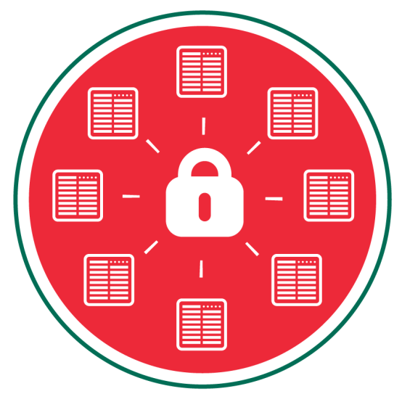
KASPERSKY’S AGENTLESS SOLUTION PROTECTS ALL YOUR VIRTUAL MACHINES WITH A SINGLE INSTALLATION
Delivering
File-level anti-malware protection
Network-level protection – using Kaspersky’s Network Attack Blocker technology
Cloud-assisted, real-time threat data – from the Kaspersky Security Network

Slide 12
KASPERSKY’S LIGHT AGENT PROTECTS WITHOUT COMPROMISING PROCESSING POWER OR STORAGE CAPACITY
Delivering
Advanced anti-malware protection
Automatic Exploit Prevention (AEP)
Advanced network-level protection
Cloud-assisted, real-time threat data – from the Kaspersky Security Network
Application Control, Device Control and Web Control support

Slide 13
DEPLOYMENT IS SIMPLE AND EVERYTHING IS DESIGNED TO KEEP YOUR BUSINESS FULLY OPERATIONAL WITH A SINGLE MANAGEMENT CONSOLE
PHYSICAL
VIRTUAL
MOBILE
Making it easier for you to migrate from physical to virtual environments… at the pace that best suits your business

Slide 14
BE THE ONE TO SECURE YOUR VIRTUAL ENVIRONMENT WITH AWARD WINNING, FORWARD THINKING, PROGRESSIVE PROTECTION WITHOUT COMPLICATION

Slide 15
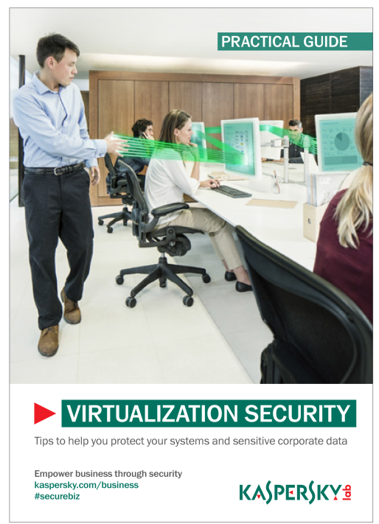
VIRTUALIZATION SECURITY
- overview
To find out more, read the Practical Guide
Empower business through security
Kaspersky.com/business
#securebiz

Slide 16
KASPERSKY LAB PROVIDES BEST IN THE INDUSTRY PROTECTION*
In 2013 Kaspersky Lab products participated in 79 independent tests and reviews. Our products were awarded 41 firsts and received 61 top-three finishes.
Score of TOP 3 places
Kaspersky Lab
1st places – 41
Participation in 79 tests/reviews
TOP 3 = 77%
Bitdefender
Symantec
Avira
Sophos
Eset
F-Secure
* Notes:
According to summary result of independent test in 2013 for corporate, consumer and mobile products
Summary includes tests conducted by the following independent test labs and magazines:
Test labs: Anti-Malware.ru, AV-Comparatives, AV-Test, Dennis Technology Labs, MRG Effitas, NSS Labs, PC Security Labs, Tolly Group, VB100
Magazines: CHIP Online, ComputerBild, Micro Hebdo, PC Magazine, PCWorld, PC Welt
The size of the bubble is number of 1st places
BullGuard
Avast
G-Data
Trend Micro
Microsoft
Panda
McAfee
AhnLab
AVG
N of independent tests/reviews
Notes:
In 2013 Kaspersky Lab products participated in 79 independent tests and reviews. Our products were awarded 41 firsts and received 61 top-three finishes.

